Slide 1
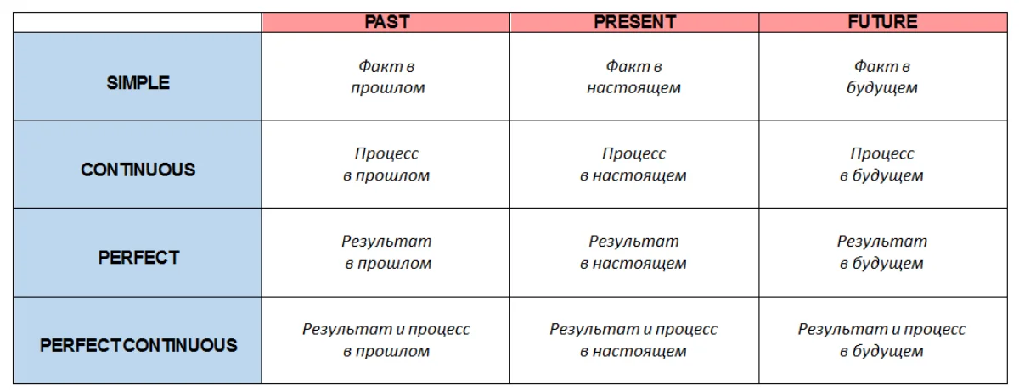
Времена в английском языке

Slide 2
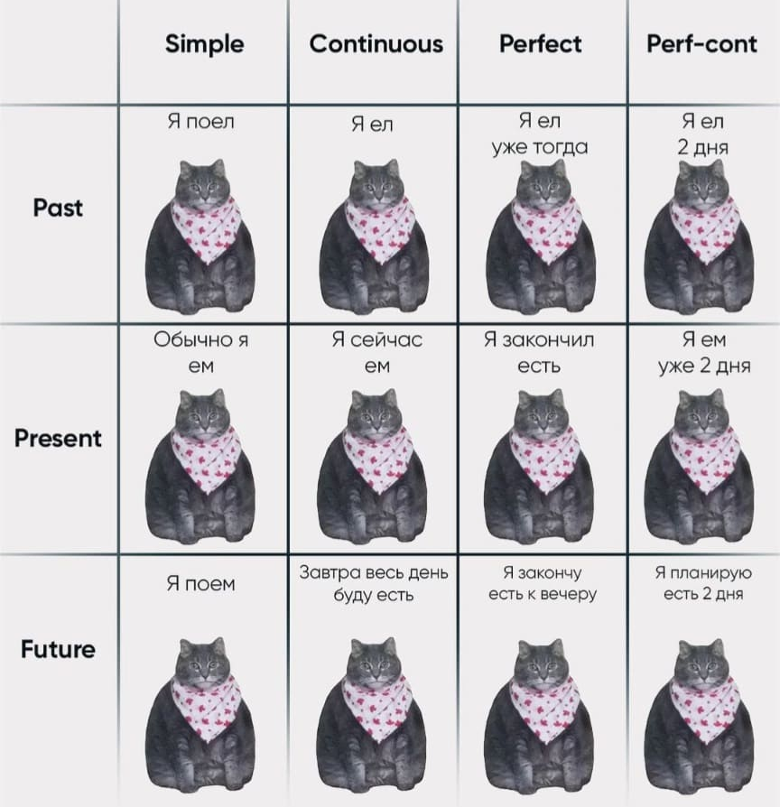

Slide 3
Present Simple /Настоящее простое время/
Используется для описания:
- повторяющихся и регулярных действий, привычек;
I brush my teeth every day.
общеизвестных фактов, законов природы;
The sun is a star.
Snow melts at 0 degrees.
- действия «сейчас» в самом широком смысле этого слова;
I study English.
I live in Kachkanar.

Slide 4
Временные маркеры /Обстоятельства времени/
regularly – регулярно;
every day – каждый день;
on Sundays – по воскресеньям;
every morning – каждое утро;
at the weekend – на выходных;
seldom – редко.

Slide 5
Мы добавляем –es, если глагол оканчивается на –o, -sh, -ch, -ss, -x.
Ex: goes, washes, dresses
to V1

Slide 6
to V1
Мы добавляем –es, если глагол оканчивается на –o, -sh, -ch, -ss, -x.
Ex: goes, washes, dresses
Глаголы to play, to go
I play every day. – Я играю каждый день
We usually play. – Мы обычно играем.
You never play. – Ты никогда не играешь.
He plays every day. – Он играет каждый день.
She plays every day. – Она играет каждый день.
It (dog) plays every day. – Он (пёс) играет каждый день.
They often play. – Они часто играют.

Slide 7
Время Present Simple образуется с помощью инфинитива смыслового глагола без частицы to, с добавлением –s (-es) в 3 лице единственного числа.

Slide 8
В 3 лице единственного числа (He, She, It) добавляем к глаголу –s.
Если глагол оканчивается на –o, -sh, -ch, -ss, -x, тогда в 3 лице единственного числа к глаголу добавляем –es.

Slide 9
to V1
Мы добавляем –es, если глагол оканчивается на –o, -sh, -ch, -ss, -x.
Ex: goes, washes, dresses
Глаголы to play, to go to speak, to watch TV
I play. – Я играю.
We play. – Мы играем.
You play. – Ты играешь.
He plays. – Он играет.
She plays. – Она играет.
It (dog) plays. – Он (пёс) играет.
They play. – Они играют.

Slide 10
to V1
Мы добавляем –es, если глагол оканчивается на –o, -sh, -ch, -ss, -x.
Ex: goes, washes, dresses
Глаголы to play, to go
I go every day. – Я хожу каждый день
We usually go. – Мы обычно ходим.
You never go. – Ты никогда не ходишь.
He goes every day. – Он ходит каждый день.
She goes every day. – Она ходит каждый день.
It (dog) goes every day. – Он (пёс) ходит каждый день.
They often play. – Они часто играют.

Slide 12
Exercise /Упражнение/
1. Her father (work) ________.
2. Her mother (stay) __________ at home.
3. Masha (drink) ________ tea every morning.
4. And her parents (drink) ___________ coffee.
5. The road to the school (take) _________ a lot of time.
6. They (go) ___________ on a bus.
7. At school Masha (sit) ___________ with Natasha.
8. They usually (talk) _____ about their favourite cartoons.
9. Masha (love) ________ to study.

Slide 13
Exercise /Упражнение/
1. My sister (to get up)_______ at six o'clock.
2. She (to go)_________ to the university in the morning.
3. She (to do)__________ her morning exercises every day.
4. For breakfast she (to have) ____ two eggs, a sandwich and a cup of tea.
5. After breakfast she (to go)_________ to the university.
6. It (to take) _______ her two hours to do his homework after classes.
7. She (to speak) ______ English well.
8. In the evening we (to gather)______ in the living-room.
9. We (to watch)__________ TV and talk.

Slide 14
Exercise /Упражнение/
Расставьте правильно формы времени, а также объясните, почему здесь используется это время.
I (to get up) at 7.30. We (to eat) breakfast, (to brush) teeth and (to go) to the classes. We (to have) English classes every day. After classes we (to play) the games.
I (to live) with a friend here. He (to speak) English very well. He (to have) a big family and they (to call) him very often. We (to play) with other children.
In the evenings we (to sit) near the fire and our teacher (to sing) songs. We never (to get) bored here. I (to like) this place very much.

Slide 15
Past Simple /Прошедшее простое время/
Используется для описания:
- описание событий в прошлом;
I saw John at school yesterday.
I met him at him street.
- перечисление последовательности в прошлом;
I saw him, then waved at him and crossed the street.
- регулярность в прошлом.
He often came here.

Slide 16
Временные маркеры /Обстоятельства времени/
Yesterday – вчера;
Just now – только что;
The other day– на днях;
Last week/month/year/morning/night – на прошлой неделе/ в прошлом месяце/ в прошлом году/ прошлым утром/ночью;
An hour ago – час назад;
In 2010 – в 2010.

Slide 17
Если глагол правильный: V 2 = V 1 + ed
Если глагол неправильный: V 2 в таблице неправильных глаголов.

Slide 19
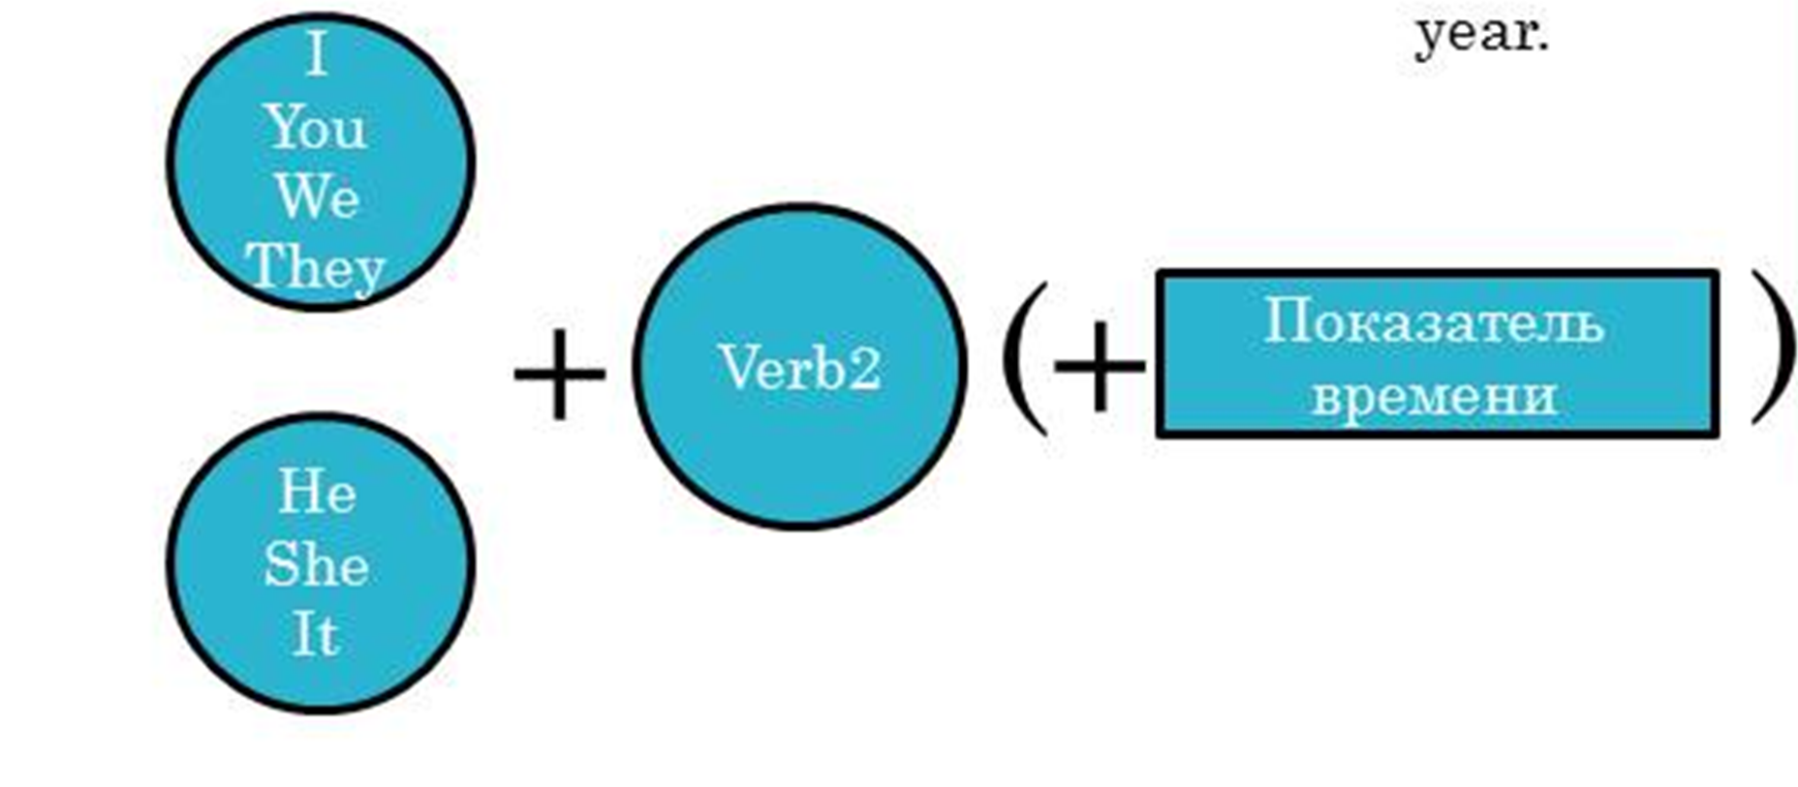
Если глагол правильный: V 2 = V 1 + ed
Если глагол неправильный: V 2 в таблице неправильных глаголов.
Глаголы to play, to go to speak, to watch TV
I . – Я играю.
We. – Мы играем.
You. – Ты играешь.
He – Он играет.
She. – Она играет.
It (dog). – Он (пёс) играет.
They. – Они играют.

Slide 20
Exercise /Упражнение/
1. Her father (work) ________ in 2010.
2. Her mother (stay) __________ at home yesterday.
3. Masha (drink) ________ tea last morning.
4. And her parents (drink) ___________ coffee two hours ago.
5. The road to the school (take) _________ a lot of time last year.
6. They (go) ___________ on a bus last week.
7. Masha (sit) ___________ with Natasha last month.
8. They (talk) _____ about their favourite cartoons last week.
9. Masha (love) ________ to study in 2020.

Slide 21
Exercise /Упражнение/
1. My sister (to get up)_______ at six o'clock last year.
2. She (to go)_________ to the university last year.
3. She (to speak) ______ English two hours ago.
4. Yesterday we (to watch)__________ TV and (to talk)___________.
5. Mary (to finish) _______ school 10 years ago.
6. Last weekend they (to go) _________ to the sea.
7. John (leave) __________ his bag in the library last Monday.
8. She (to visit) _____________ her best friend yesterday evening.
9. We (to play) ____________ with other children last Sunday.
10. Yesterday we (to eat) _______ breakfast, (to brush) _______ teeth and (to go) __________ to the classes.

Slide 22
Future Simple /Будущее простое время/
Используется для описания:
- простых будущих событий;
I will call you tomorrow.
регулярных действий в будущем;
I will come here every year.
- последовательности в будущем;
I will come home,
my mother will give us some food
and we will hit the road.

Slide 23
Временные маркеры /Обстоятельства времени/
tomorrow – завтра;
the day after tomorrow – послезавтра;
tonight – сегодня вечером;
in the future – в будущем;
soon – скоро;
next week/month/year – на следующей неделе/в следующем месяце/году
in an hour/minute – через час/минуту
later – позже;
in 2050 – в 2050 году.

Slide 26
Exercise /Упражнение/
1. Her father (work) ________ in 2050.
2. Her mother (stay) __________ tomorrow.
3. Masha (drink) ________ tea tonight.
4. And her parents (drink) ___________ coffee next week.
5. The road to the school (take) _________ a lot of time in the future.
6. They (go) ___________ on a bus next year.
7. Masha (sit) ___________ with Natasha in an hour.
8. They (talk) _____ about their favourite cartoons the day after tomorrow .

Slide 27
Exercise /Упражнение/
1. -Mary called you last night. — Ok. I (to call back) in a minute.
2. They (to go) on a picnic tomorrow? — I do not think so. The weather (not/to get) better.
3. His parents believe that she (to become) an artist one day.
4. -I (to buy) that dress, — she said to the shop assistant.
5. Monica (to be) 5 years old next month.
6. What you (to get) for her birthday? I really have no ideas.
7. -We are running out of petrol! — Don’t worry. We (to get) some on our way back.
8. -Have you made up your mind about what to do with that offer? —Yes. I believe I (not/to reject) it.
9. I (to protect) you from anything, my dear baby.
10. I am not confident in my knowledge. I think I (not/to pass) the test. It scares me.
11.After breakfast I (to set off) to the school. It is one day before the exam.

Slide 28
Negative sentences in the Present Simple
/Отрицательные предложения в настоящем простом времени/
The Subject (подлежащее) + do / does + not + V1
I
We
You
They
Do
Not
V1
He
She
It
Does

Slide 29
Составьте отрицательные предложения
Exercise /Упражнение/
I go. – Я хожу.
We go. – Мы ходим.
You go. – Ты ходишь.
He goes. – Он ходит.
She goes. – Она ходит.
It (dog) goes. – Он (пёс) ходит.
They go. – Они ходят.
I do not go. – Я не хожу.
We do not go. – Мы не ходим.
You do not go. – Ты не ходишь.
He does not go. – Он не ходит.
She does not go. – Она не ходит.
It (dog) does not go. – Он (пёс) не ходит.
They do not go. – Они не ходят.

Slide 30
Exercise /Упражнение/
1. My sister (to get up)_______ at six o'clock.
2. She (to go)_________ to the university in the morning.
3. She (to do)__________ her morning exercises every day.
4. For breakfast she (to have) ____ two eggs, a sandwich and a cup of tea.
5. After breakfast she (to go)_________ to the university.
6. It (to take) _______ her two hours to do his homework after classes.
7. She (to speak) ______ English well.
8. In the evening we (to gather)______ in the living-room.
9. We (to watch)__________ TV and talk.

Slide 31
Exercise /Упражнение/
Расставьте правильно формы времени. Запишите все предложения в отрицательной форме.
I (to get up) at 7.30. We (to eat) breakfast, (to brush) teeth and (to go) to the classes. We (to have) English classes every day. After classes we (to play) the games.
I (to live) with a friend here. He (to speak) English very well. He (to have) a big family and they (to call) him very often. We (to play) with other children.
In the evenings we (to sit) near the fire and our teacher (to sing) songs. We (to get) bored here. I (to like) this place very much.

Slide 32
Negative sentences in the Past Simple
/Отрицательные предложения в прошедшем простом времени/
The Subject (подлежащее) + did + not + V1
I
We
You
They
Did
Not
V1
He
She
It

Slide 33
Exercise /Упражнение/
1. My sister did not get up at six o'clock last year.
2. She (to go)_________ to the university last year.
3. She (to speak) ______ English two hours ago.
4. Yesterday we (to watch)__________ TV and (to talk)___________.
5. Mary (to finish) _______ school 10 years ago.
6. Last weekend they (to go) _________ to the sea.
7. John (leave) __________ his bag in the library last Monday.
8. She (to visit) _____________ her best friend yesterday evening.
9. We (to play) ____________ with other children last Sunday.
10. Yesterday we (to eat) _______ breakfast, (to brush) _______ teeth and (to go) __________ to the classes.

Slide 34
Negative sentences in the Future Simple
/Отрицательные предложения в будущем простом времени/
The Subject (подлежащее) + will + not + V1
I
We
You
They
Will
Not
V1
He
She
It

Slide 35
Exercise /Упражнение/
1. Her father will not work in 2050.
2. Her mother (stay) __________ tomorrow.
3. Masha (drink) ________ tea tonight.
4. And her parents (drink) ___________ coffee next week.
5. The road to the school (take) _________ a lot of time in the future.
6. They (go) ___________ on a bus next year.
7. Masha (sit) ___________ with Natasha in an hour.
8. They (talk) _____ about their favourite cartoons the day after tomorrow .

Slide 36
Interrogative sentences in the Present Simple
/Вопросительные предложения в настоящем простом времени/
Do / Does + the Subject (подлежащее) + V1?
I
We
You
They
Do
V1
He
She
It
Does

Slide 37
Exercise /Упражнение/
1. Does my sister get up at six o'clock?
2. Does she go to the university in the morning?
3. She (to do)__________ her morning exercises every day.
4. She (to have) ____ two eggs, a sandwich and a cup of tea.
5. She (to go)_________ to the university.
6. It (to take) _______ her two hours to do his homework after classes.
7. She (to speak) ______ English well.
8. We (to gather)______ in the living-room.
9. We (to watch)__________ TV and talk.

Slide 38
Interrogative sentences in the Past Simple
/Вопросительные предложения в прошедшем простом времени/
Did + the Subject (подлежащее) + V1?
I
We
You
They
Did
V1
He
She
It

Slide 39
Exercise /Упражнение/
1. Did my sister get up at six o'clock last year?
2. She (to go)_________ to the university last year.
3. She (to speak) ______ English two hours ago.
4. Yesterday we (to watch)__________ TV and (to talk)___________.
5. Mary (to finish) _______ school 10 years ago.
6. Last weekend they (to go) _________ to the sea.
7. John (leave) __________ his bag in the library last Monday.
8. She (to visit) _____________ her best friend yesterday evening.
9. We (to play) ____________ with other children last Sunday.
10. Yesterday we (to eat) _______ breakfast, (to brush) _______ teeth and (to go) __________ to the classes.

Slide 40
Interrogative sentences in the Future Simple
/Отрицательные предложения в будущем простом времени/
Will + the Subject (подлежащее) + V1?
I
We
You
They
Will
V1
He
She
It

Slide 41
Exercise /Упражнение/
1. Will her father work in 2050?
2. Her mother (stay) __________ tomorrow.
3. Masha (drink) ________ tea tonight.
4. And her parents (drink) ___________ coffee next week.
5. The road to the school (take) _________ a lot of time in the future.
6. They (go) ___________ on a bus next year.
7. Masha (sit) ___________ with Natasha in an hour.
8. They (talk) _____ about their favourite cartoons the day after tomorrow .

Slide 42
Задание: переведите предложения.
Я хожу в школу каждый день.
Я не хожу в школу каждый день.
Хожу ли я в школу каждый день?
Она любит свою маму.
Она не любит свою маму.
Любит ли она свою маму?
Я жил в Качканаре прошлым летом.
Я не жил в Качканаре прошлым летом.
Жил ли я в Качканаре прошлым летом?
Он будет говорить на английском языке в следующем году.
Он не будет говорить на английском языке в следующем году.
Будет ли он говорить на английском языке в следующем году?

