Slide 1
Chess boxing, or chessboxing,
is a hybrid sport that combines two traditionalиpastimes: chess and boxing. The competitors compete in alternating rounds of chess and boxing.
World champions
Iepe Rubingh, Netherlands (2003) – Middleweight
Frank Stoldt , Germany (2007) – Light heavyweight
Nikolay Sazhin , Russia (2008) – Light heavyweight
Leonid Chernobaev, Belarus (2009) – Light heavyweight

Slide 2
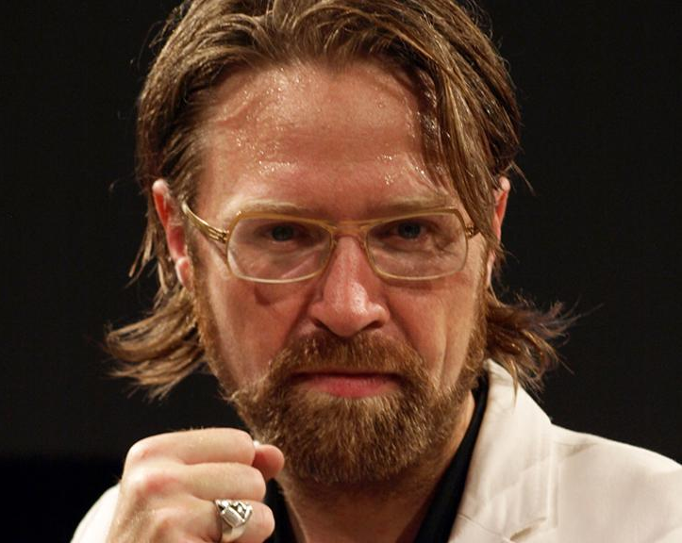
The World Chess Boxing Organisation (WCBO) is the leading umbrella organisation for international amateur chessboxing. It is based in Berlin, Germany
Iepe Rubingh founded the World Chess Boxing Organisation directly after the first chessboxing fight in 2003.
«Fighting is done in the ring and wars are waged on the board»
Chessboxing Rules
A chessboxing match can end by any of the following:
Victory by knockout or technical knockout in boxing.
Victory by checkmate in chess.
Loss due to exceeding the chess game's time control.
Victory due to disqualification of their opponent by the referee e.g. due to inactivity due to overextended playing time (chess or boxing rounds following multiple warnings).
This rule prevents a player who is in an obviously lost position in one arena from stalling in order to attempt to win in the other.
Loss by resignation (chess or boxing rounds).
In the case that neither of the chessboxers win in regulation time and the chess game ends in a draw, the fighter who is ahead on boxing points wins the overall bout. In case the scoreboard is also tied, the fighter that used the black chess pieces will be named the winner (due to the first-move advantage in chess). This has not yet occurred in practice.

Slide 3
Список терминов
1. Chess boxing, or chessboxing – шахбокс
2. Pastime – игра, занятие
3. Chess – шахматы
4. Boxing - бокс
5. Competitors – соперники
6. Round – раунд
7. Middleweight – средний вес
8. Light heavyweight - полутяжёлый вес
9. The World Chess Boxing Organisation (WCBO) – Всемирная организация по шахбоксу
10. Match – матч
11. Knockout – нокаут
12. Checkmate – победа в шахматах
13. Disqualification – дисквалификация
14. Referee – судья
15. Warning – предупреждение
16. Be named the winner – быть объявленным победителем
17. Chess pieces – шахматные фигуры
18. Chess game – шахматная партия
19. Scoreboard - табло
20. In a draw – вничью

Slide 4
Можете выбрать любой вид спорта по этой ссылке (или найти в интернете самостоятеяльно)и написать о нём по примеру шахбокса
https://vk.com/@gto_kalin-top-16-samye-neobychnye-i-maloizvestnye-vidy-sporta

